Slide 1
Case Study – Credit Card Marketing
IE 509: Six Sigma Quality
Presented by
Gabriel Colangelo

Slide 2
Introduction
An experiment was designed using 2^k factorial design to see if the number of credit card orders was affected by changing the certain factors
The following 4 factors were involved: annual fee, account operating fee, initial interest rate, and long-term interest rate
The levels for each factor were as follows: (-/+) = (control/new idea)
Keep (-) or lower annual fee(+)
Keep (-) or lower initial interest rate (+)
Higher (+) or low (-) long term interest rate
No account operating fee (-) or include account operating fee (+)

Slide 3
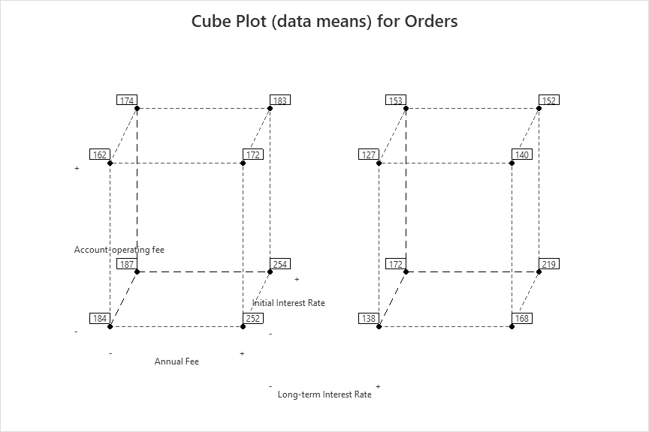
Cube Plot
The following cube chart was generated for this designed experiment and its collected data
The data means can be seen at each corner of the cube for the given factor

Slide 4
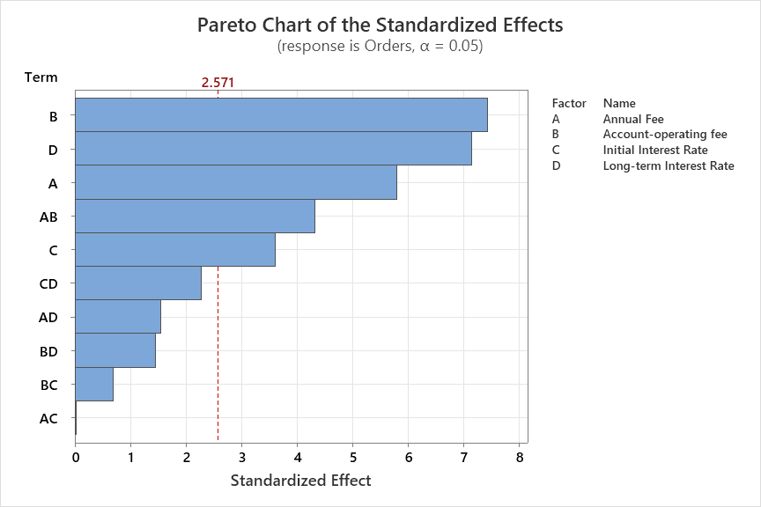
Analysis
By analyzing the factorial design using only 2nd order terms with a .05 statistical significance level, the following information was gathered
All 4 factors were statistically significant
There was also a statistically significant interaction between the annual fee and the account operating fee

Slide 5
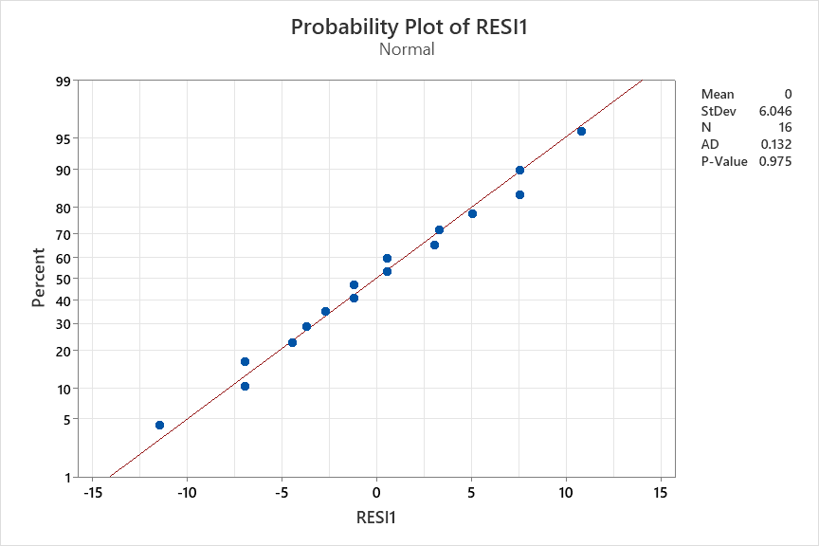
Analysis
To verify our analysis is valid, the following ANOVA assumptions were verified
The mean of the residuals is 0
The residuals are normally distributed
Both are verified as shown in the attached plot as the mean is 0 and the necessary P-value is met
The P-value is greater than 0.05 so we cannot conclude that the residuals don’t follow a normal distribution.

Slide 6
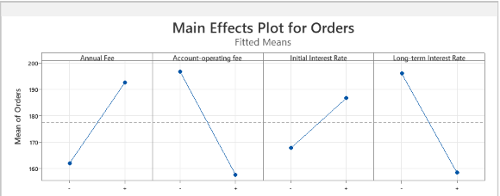
Main Effects Plot
From our experiment data, the main effects plot was generated
From this we can see that the number of orders are maximized for the following cases
Lower Annual Fee
No Account Operating Fee
Lower Initial Interest Rate
Low Long Term Interest Rate

Slide 7
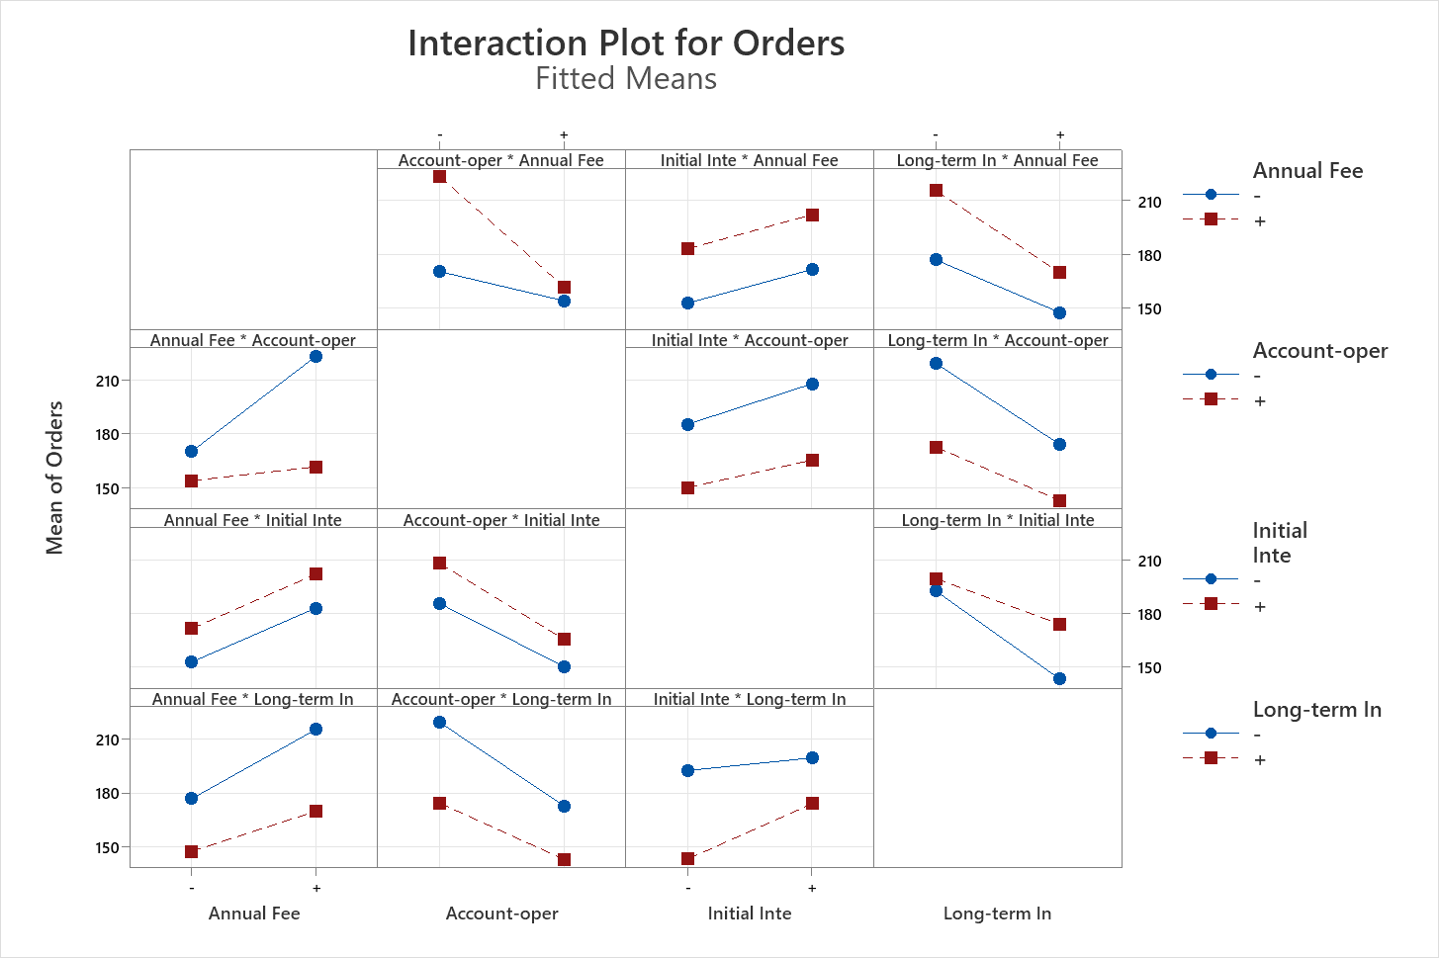
Interaction Matrix
Similarly, the following Interaction matrix was generated.
Analyzing the slopes of the lines In the plots, the following interactions were found to be significant
The interaction between Account Operating Fee and Annual Fee
The interaction between long term interest rate and initial interest rate

Slide 8
Interaction Matrix
It can be observed that for the interaction between the Account Operating Fee and the Annual Fee, the number of credit card orders are maximized when there is no Account Operating Fee coupled with a Lower Annual Fee. Gives 223 Orders on average
It can be observed that for the interaction between the Long-Term Interest Rate and the Initial Interest Rate, the number of credit card orders are maximized when there is a Lower Initial Interest Rate and Low Long Term Interest Rate. Gives 199 orders on average.

Slide 9
Conclusions
It was found that all 4 factors were statistically significant or a level of 0.05 (ANOVA assumptions were validated)
The most significant interaction occurs between the account operating fee and annual fee
Based on the data, to maximize the number of credit card orders, there should be a lower annual fee, no account operating fee, a lower initial interest rate and a low long-term interest rate
If only one interaction could be implemented to maximize the number of credit card orders, then there should be is no account operating fee and a lower annual fee
It should be noted that if the response variable changes from the number of orders, these optimum conditions and conclusions about the experiment would also change.

